Slide 1
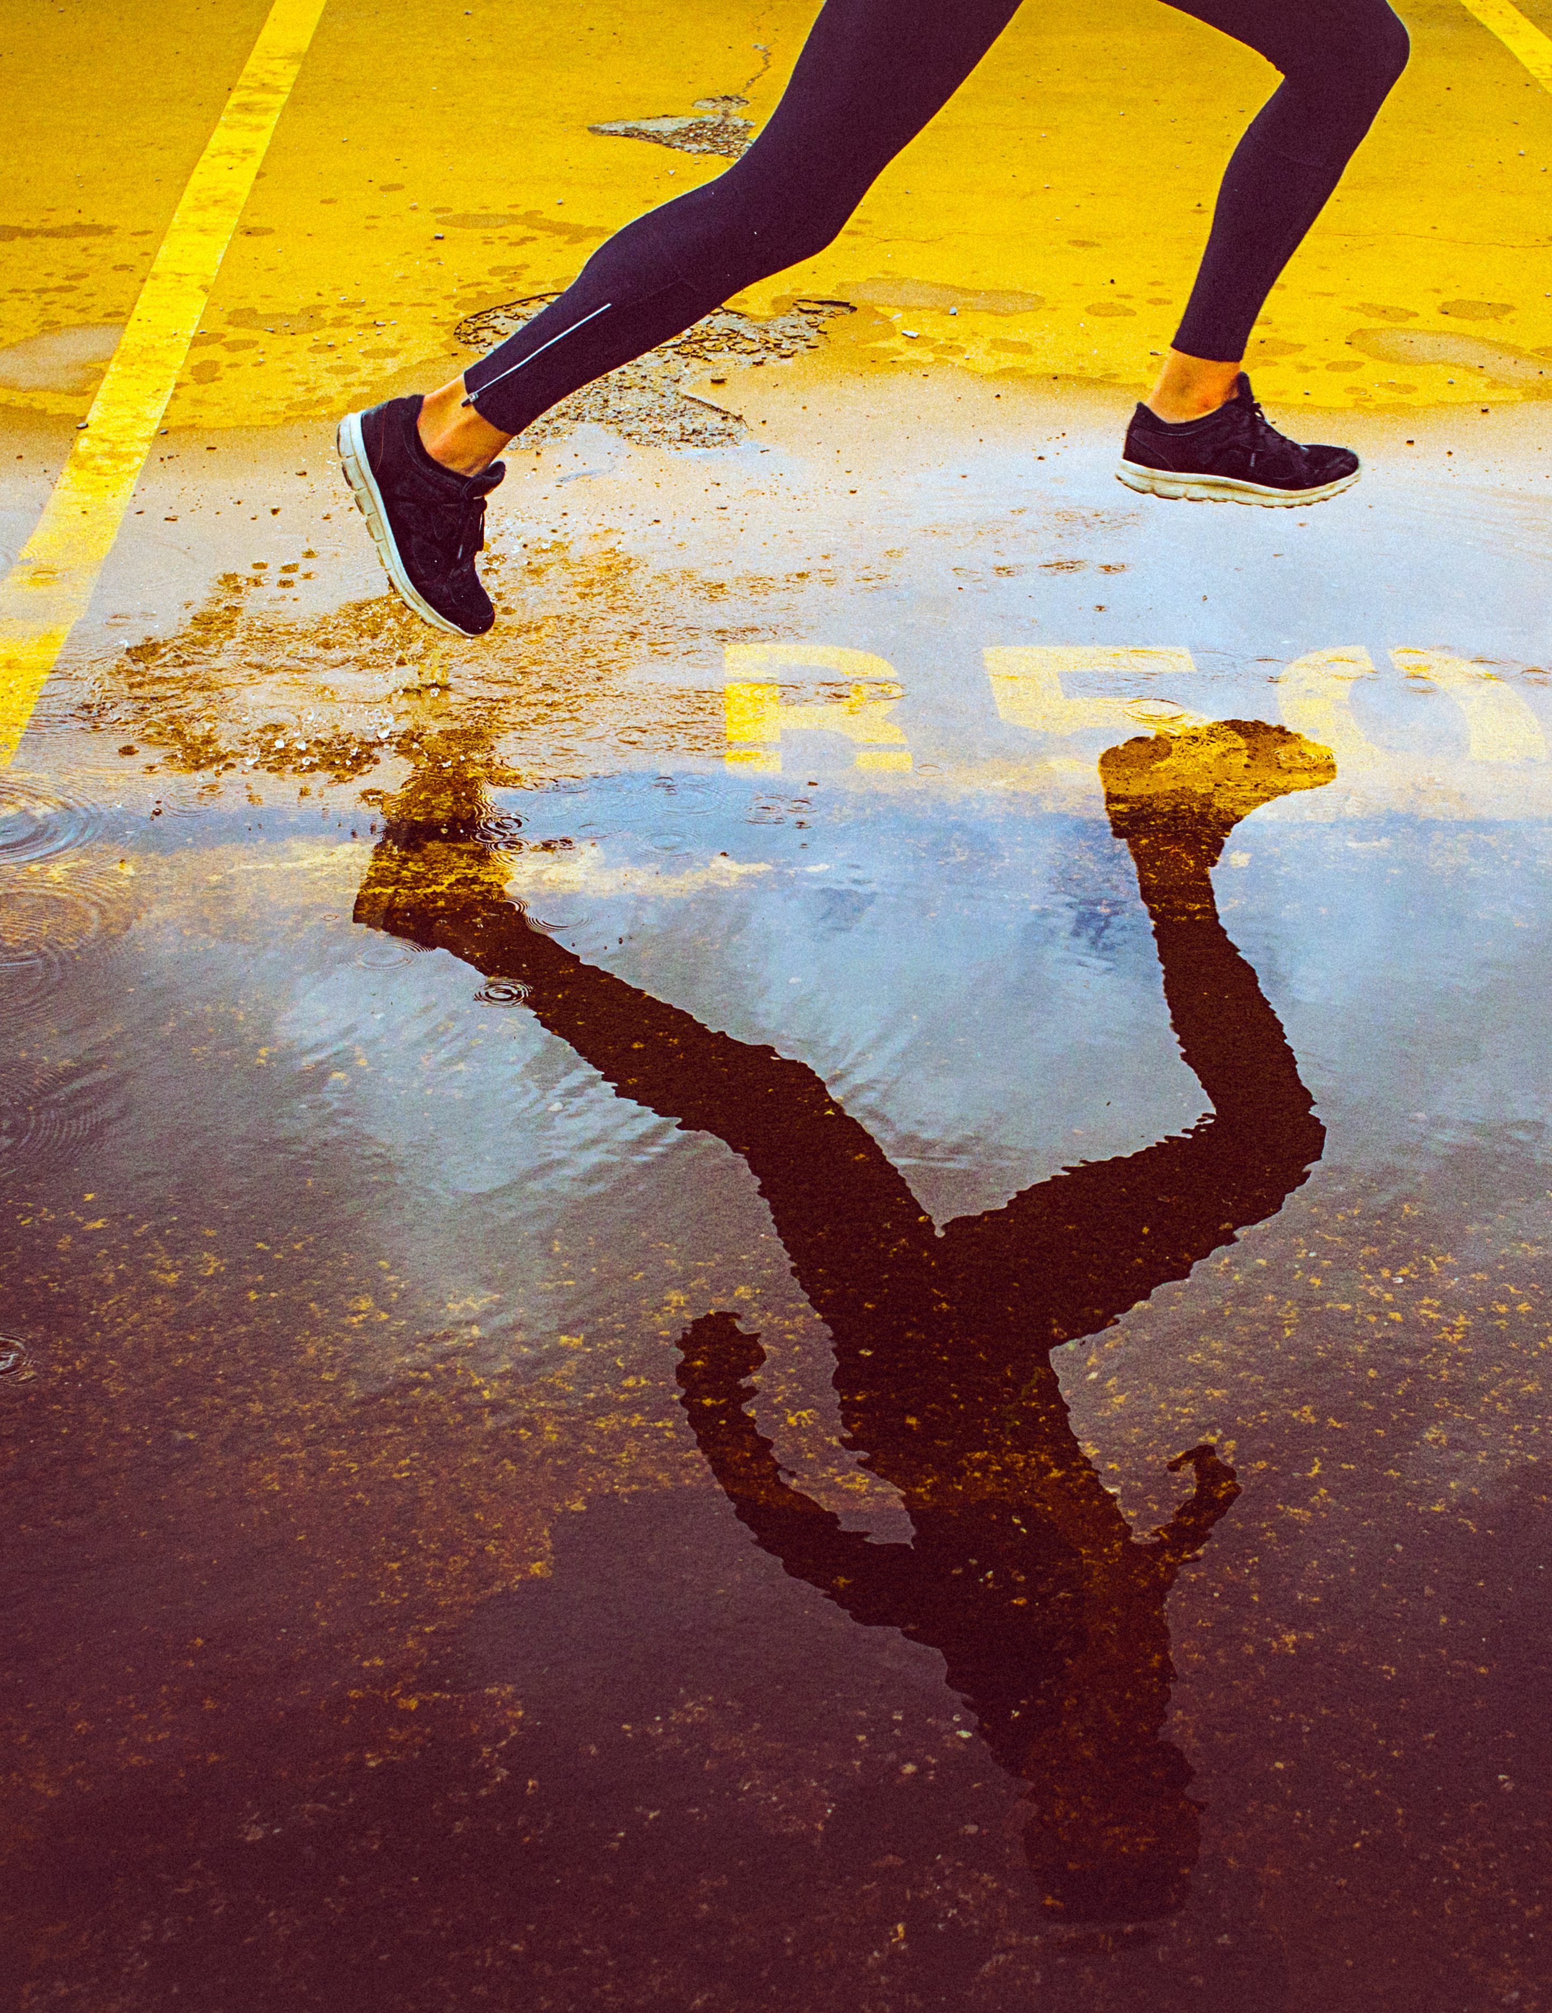
*****
Solved by:
Ali, Aidan, Gaurav, Pankaj and Sharod

Slide 2
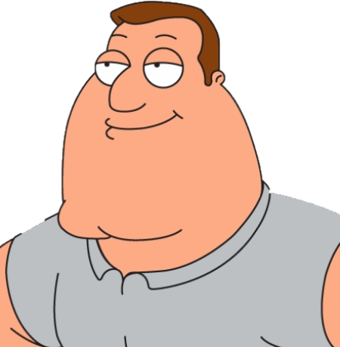
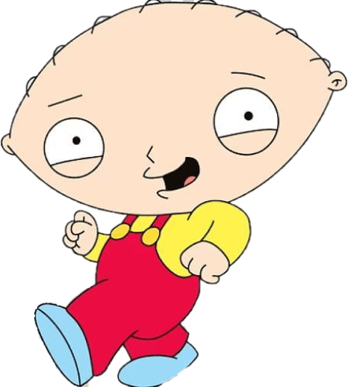
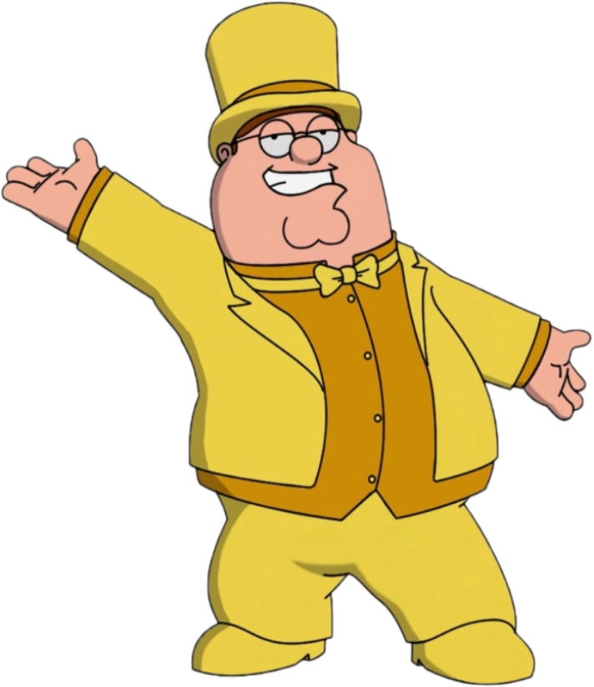
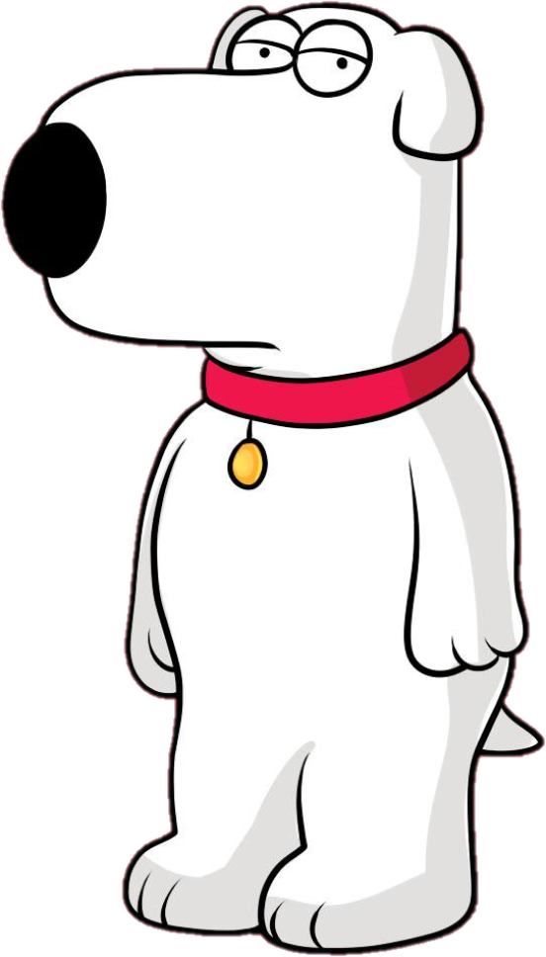
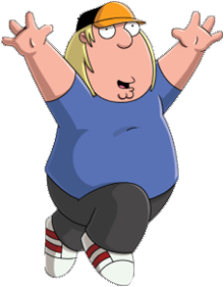
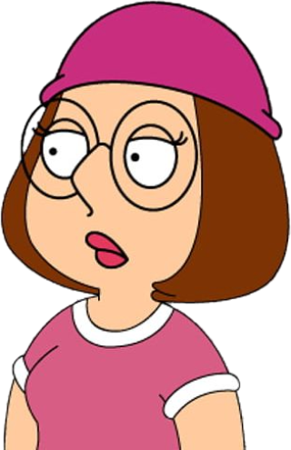
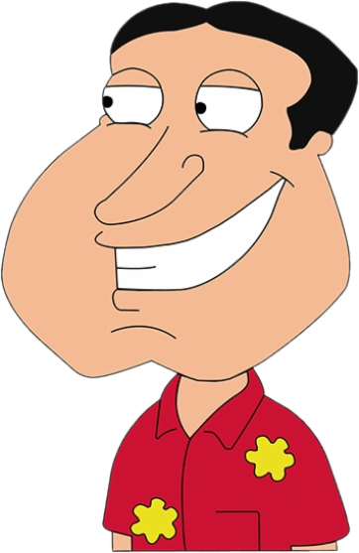
Let’s understand the players
Stewie
Joe
Peter
Chris
Glenn
Meg
brian
Event Organizer
(Concert, Movie Theatre,
Sports Events, etc.)
First Buyer
(Purchases the ticket directly
from event organizer)
Late Buyers
(Purchases the ticket first
Buyers via Auction or at premium)
Know it all Blockchain Expert

Slide 3

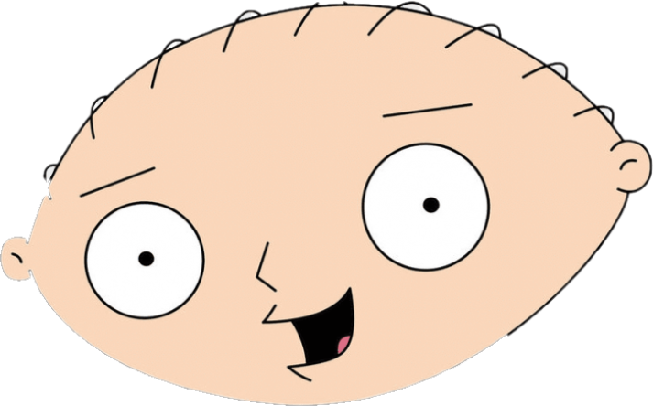
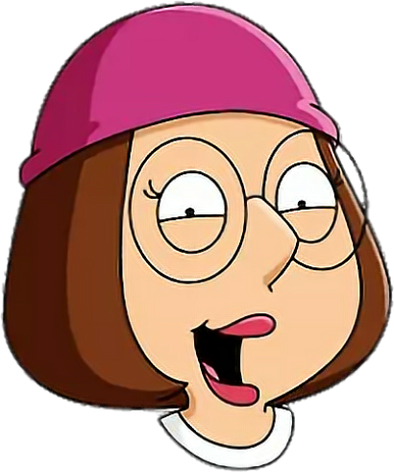
Scenario - I
Stewie buys Avengers Endgame
ticket from Peter for $20
Now, Meg afraid that someone will spoil the ending for her,
she buys same ticket from Stewie for $40

Slide 4
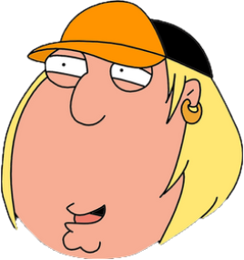

Scenario - II
Peter the painter sells his painting
to Chris for $500
3 years later as Peter becomes recognized, same painting is
sold to Glenn for $10,000 at an Auction.

Slide 5
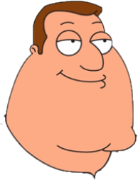
Scenario - III
Peter sells NBA Final courtside
tickets to Chris for $350
With his favorite team in finals, Joe decides to buy
the tickets from Chris at $500

Slide 6
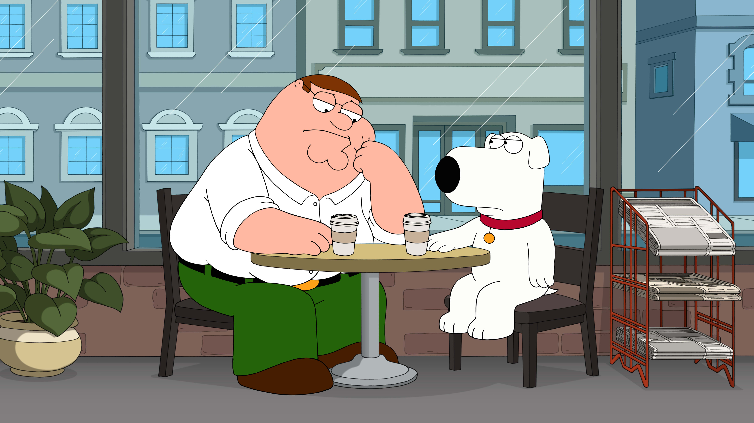
How can I ensure that there are no resells of the tickets or maintain the authenticity of the tickets sold at major sports events or even at the Auction?
You are thinking way too much. All this can be easily solved if you tokenize what you sell.
Let’s have the team show it to you.

Slide 7
Screenshots from Solidity can go on following slides

